Slide 1
Cryptocurrency and Negative Environmental Impacts

Slide 2


The Idea
Idea emerged in 1983 in a paper published by Davaid Chaum
The goal was to create a decentralized currency that was able to be sent and received without being tracked

Slide 3

Early Implementations
Chaum created “digicash” in 1995 to demonstrate some of the elements of cryptocurrency
In 1998 Nick Szabo developed “Bit Gold” which more closely resembled crypto today
He was not able to solve the problem of the currency being easily duplicated as it was a digital asset

Slide 4

Bitcoin
Bitcoin white paper was published on October 31st, 2008 by a group of developers under the pseudonym Satoshi Nakamoto
This was where the idea of the blockchain first came from, which solved the duplication problem that Bit Gold had

Slide 5

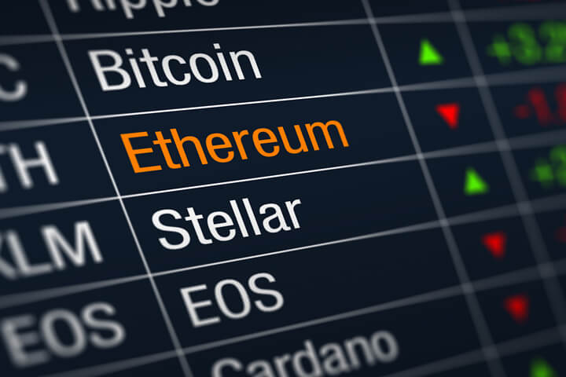
Rise of crypto
Over the years the popularity of cryptocurrency has experienced a huge surge
Started with just Bitcoin but many more currencies emerged
People like it due to decentralization

Slide 6
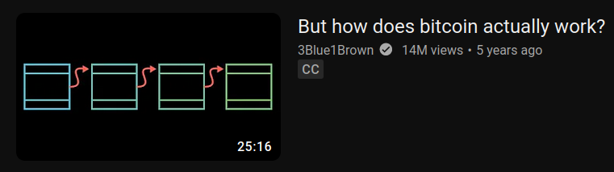
Blockchain
Essentially an unchangeable record consisting of “blocks” that are linked together
These blocks can hold any information but they always have information about the block in front of them and the block behind them
Because each block contains information about the blocks surrounding it in the chain it makes it nearly impossible to alter the chain
In the context of Bitcoin it was used to keep a record of every transaction of every bitcoin that could not be altered

Slide 7

Mining
In order to add a block a “miner” must compete with other miners to solve complicated math problems
This is usually done by guessing the answer by trying to submit as many possible answers as possible
The first miner to guess the correct answer is rewarded with some amount of cryptocurrency
For most currencies the reward gets reduced as more blocks are added
The process of guessing requires powerful computer hardware, usually GPUs

Slide 8
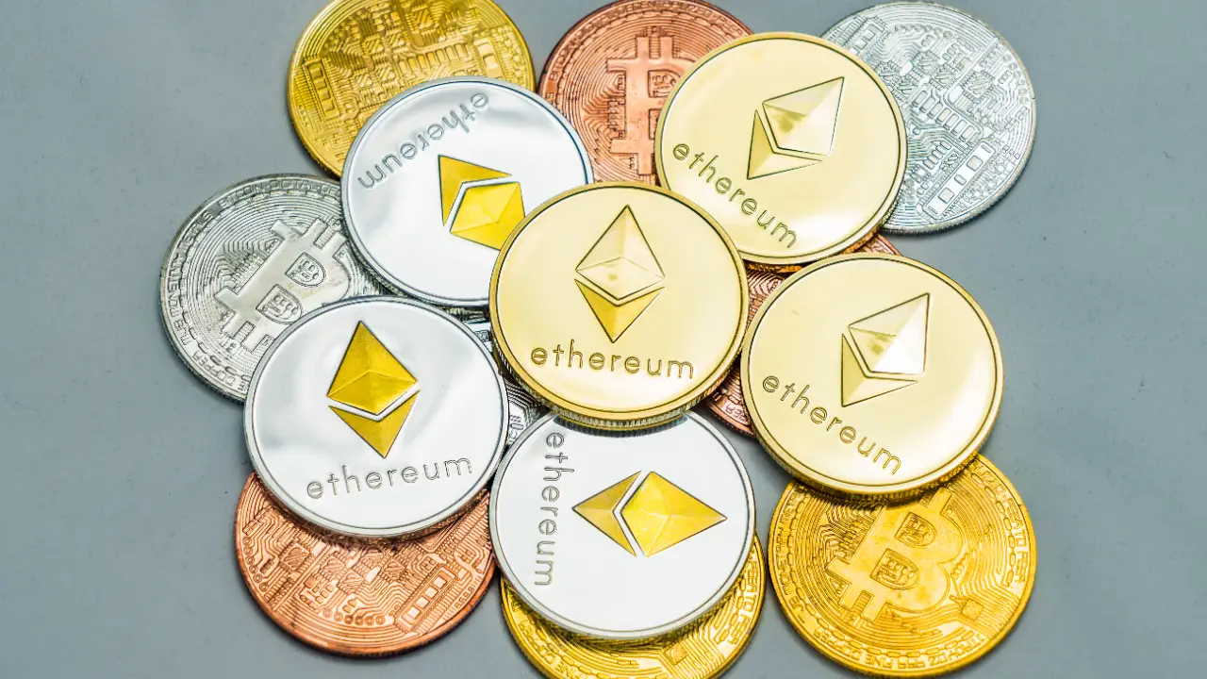
How crypto is used
Crypto exchanges
Binance, FTX, Coinbase
Avoiding currency conversions
Fast transactions
NFTs
Speculation

Slide 9

Crypto exchanges
Take money in exchange for crypto
Take crypto in exchange for crypto
Allows you to buy in or cash out

Slide 10

NFTs
Token on a blockchain that represents a picture
Monkey jpeg
Not really a crypto but related

Slide 11
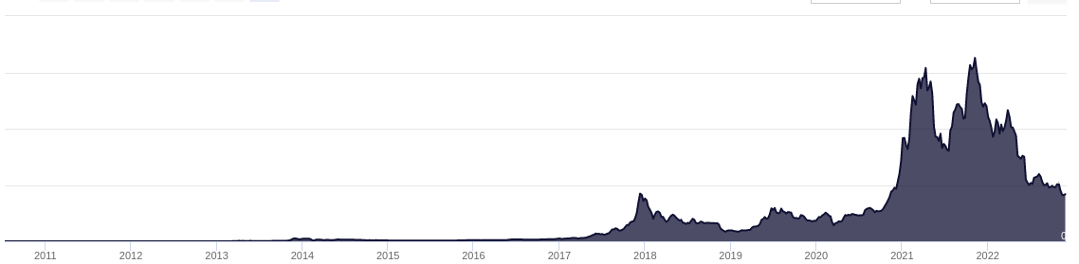
Speculation
No physical conversion to crypto allows value to fluctuate wildly
People buy in in hopes that the value will increase

Slide 12
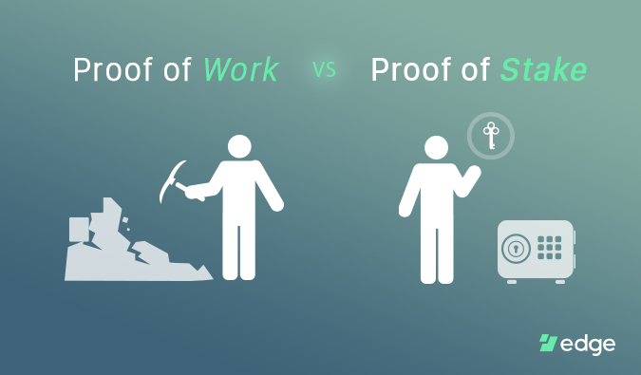
Proof of Work and Proof of Stake
Proof of work involves miners to solve an arbitrary math question
Very expensive electricity cost
The user who solves problem appends new list to blockchain and is rewarded
The problem: Everyone is doing these expensive calculations without any need for them to be done
Proof of Work can be susceptible to exploits like the 51/50 attack

Slide 13
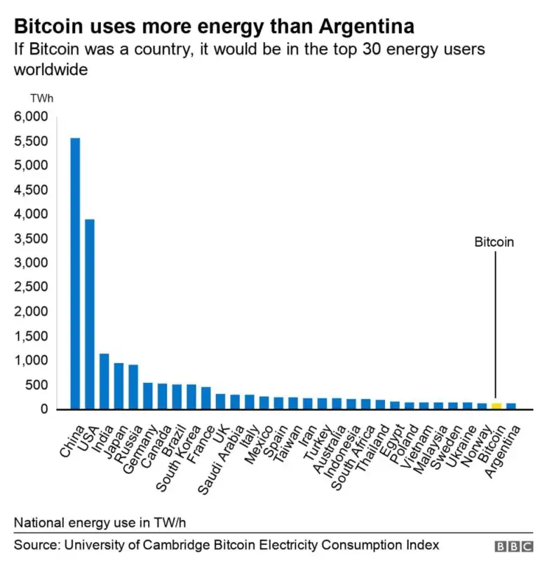
Energy consumption
Proof of Work Mining uses the amount of electricity to power countries such as Argentina or Australia (Business Insider)
The University of Cambridge estimates Bitcoin generates 133 TWh annually
This surpasses the annual energy use of Norway in 2020
From 2018-2022, annual energy use from global crypto-assets went from doubling to quadrupling
120-240 TWh per year
0.4-0.9% of annual global electricity usage

Slide 14
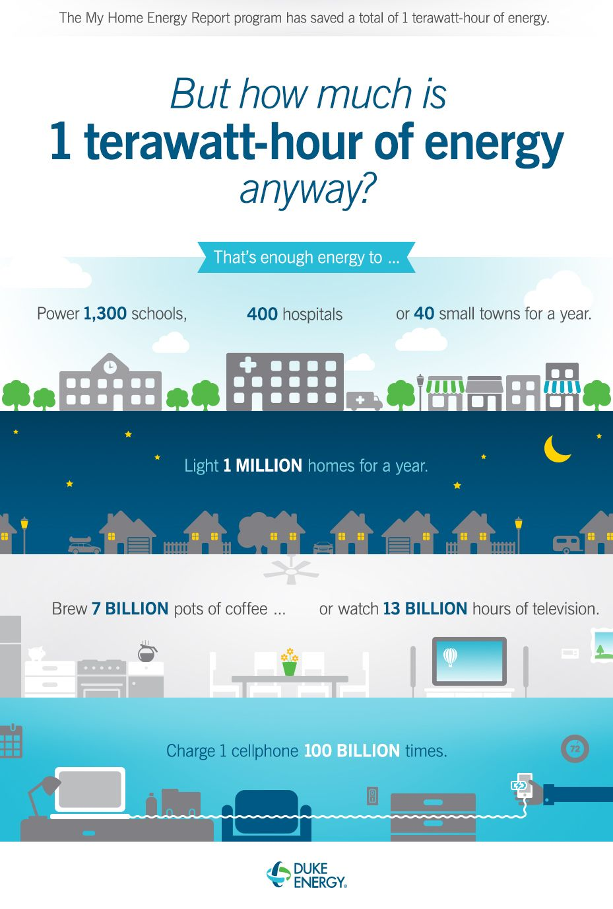
How much are we spending?
The Digiconomist's Bitcoin Energy Consumption Index estimated that one bitcoin transaction takes 1,449 kWh to complete, or the equivalent of approximately 13 years of power for the average US household.
One kWh is about $0.166, meaning about 240 dollars is spent for a transaction
The amount of energy spent on crypto is enough to put it in the top 30 countries with highest energy use
Total bitcoin energy use is around 200 tWh (between late 2021 early 2022)

Slide 15
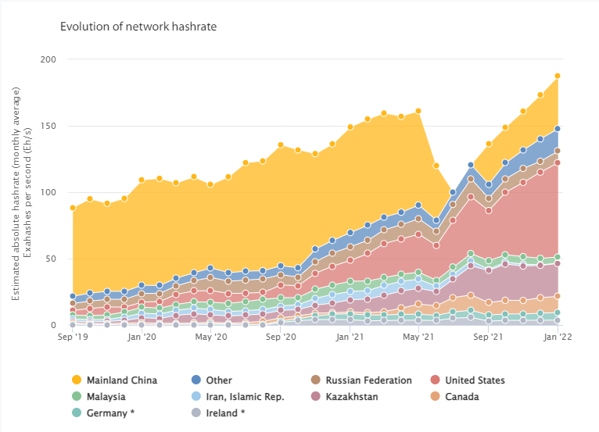
Worldwide hashrate share
United States 71 Eh/s
Mainland China 39.6 Eh/s
Kazakhstan 24.8 Eh/s
Other 16.9 Eh/s
Canada 12.1 Eh/s
Russian Federation 8.7 Eh/s
Germany 5.7 Eh/s
Malaysia 4.7 Eh/s
Ireland 3.7 Eh/s
Iran 0.2 Eh/s
Eh/s = Exahash rate per second
1 Quintillion Hashes per second
* To our knowledge, there is little evidence of large mining operations in Germany or Ireland that would justify these figures. Their share is likely significantly inflated due to redirected IP addresses via the use of VPN or proxy services.
https://ccaf.io/cbeci/mining_map

Slide 16
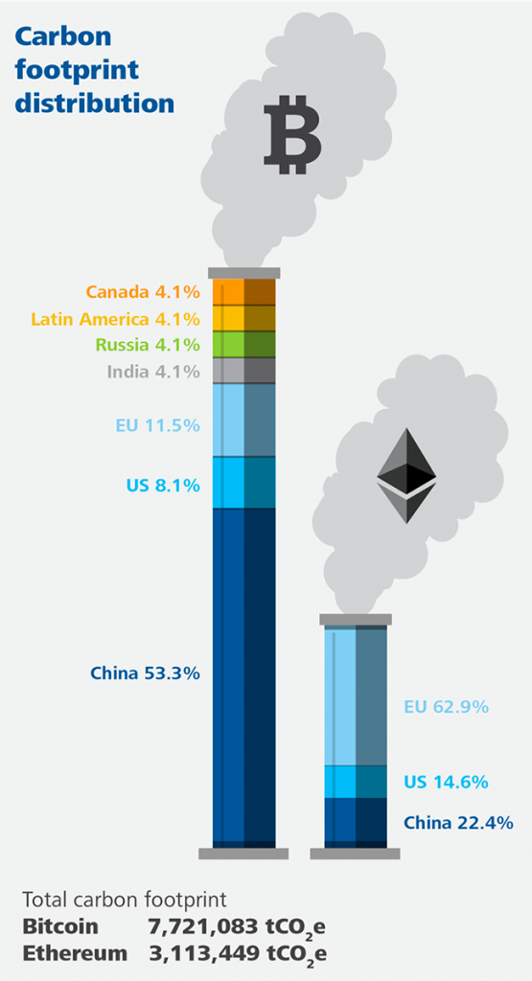
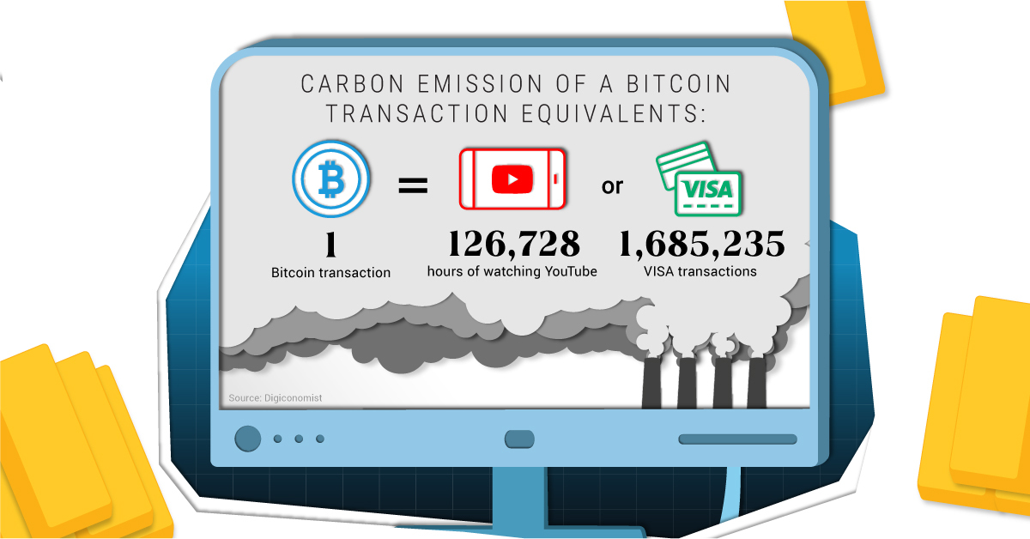
Carbon emissions
The rapid growth of crypto and the energy used to create it may hinder the US efforts to reach net-zero carbon pollution (White House)
In 2020, the US created nearly 40 billion pounds of CO2 emissions (Business Insider)

Slide 17


Asic miners & mining farms
Application-Specific Integrated Circuit Miners
Creates a lot of waste - need a sustainable way to recycle old computer parts
Unsustainable - need a sustainable way to supply the energy needed for the computing power of miners

Slide 18
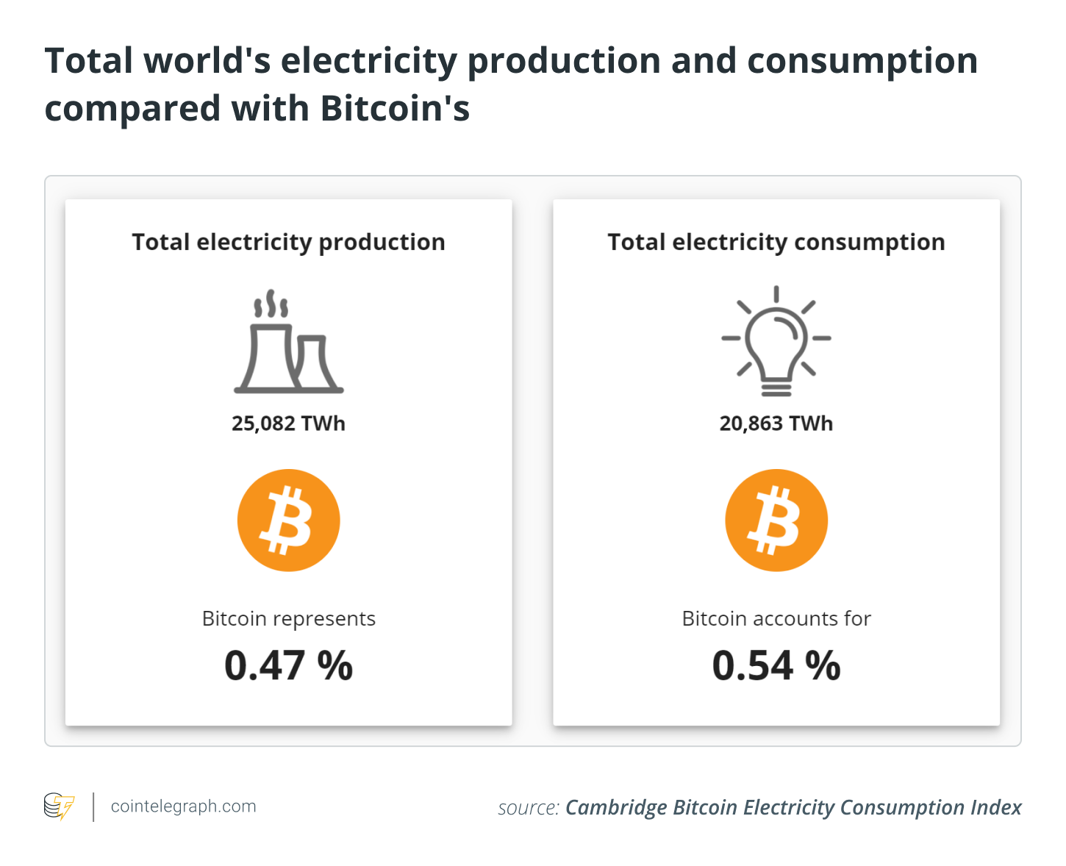
How to limit energy usage
Instead of useless computations, we can have users “stake” their pre-existing coins
No electricity spent on thousands of hours of computation
The user who stakes the most coins gets to append the new list to blockchain and is rewarded
You need a lot of coins to become a validator (about 1275 USD worth of ETH as of 12/4/22)
Proof of Stake could still be susceptible to exploits like the 51/50 attack

Slide 19
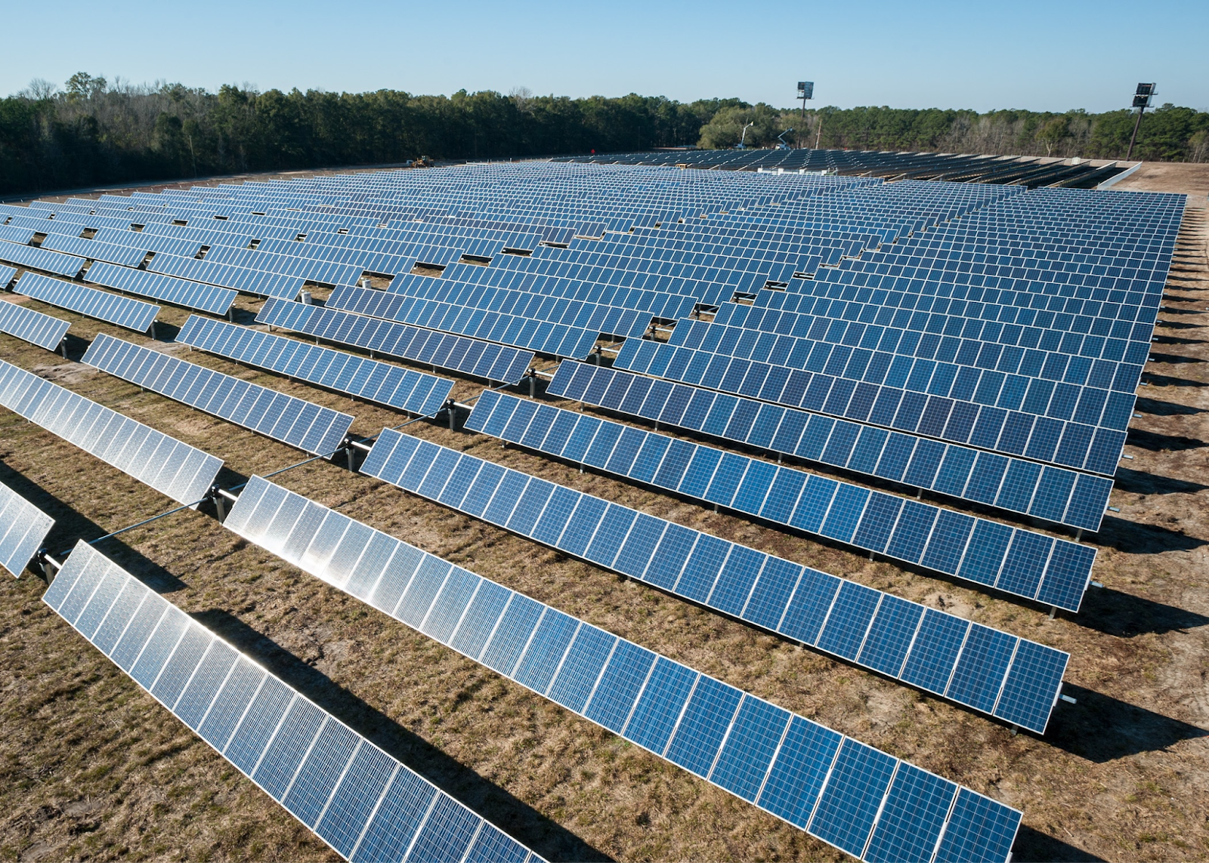

What’s next?
Ensuring the Responsible Development of Digital Assets includes reducing the negative climate impacts and environmental pollution creates from these assets (White House)
The Crypto Climate Accord commits to reducing carbon emissions to net-zero by 2030 and eventually decarbonizing the industry by 2040 (Business Insider)
Green crypto mining: uses renewable energy sources such as solar, hydroelectric, and nuclear energy

